Slide 1
Intro to Neural Nets
Model Fitting

Slide 2
Today’s Agenda
General Workflow
Step 1: Get your model to overfit on training data (always possible).
Step 2: Get your model to fit to validation data (this is quite exploratory)
Step 3: Maximize out of sample performance by mitigating / delaying overfitting in training data.
Techniques to Mitigate Overfitting
Early stopping (we’ve seen this already, and we will do it regularly).
Regularizing or constraining weights
Dropout
Adjust batch size
Inject noise
Get better / more data
Some Rules of Thumb
Examples + Competition + Homework Assignment #1

Slide 3
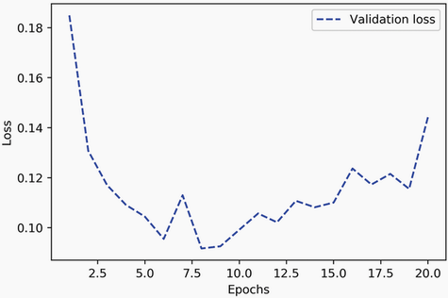
Early Stopping
Monitoring Validation Performance and then Manually Limiting Epoch Count
This is the sole approach we have been taking thus far.

Slide 4
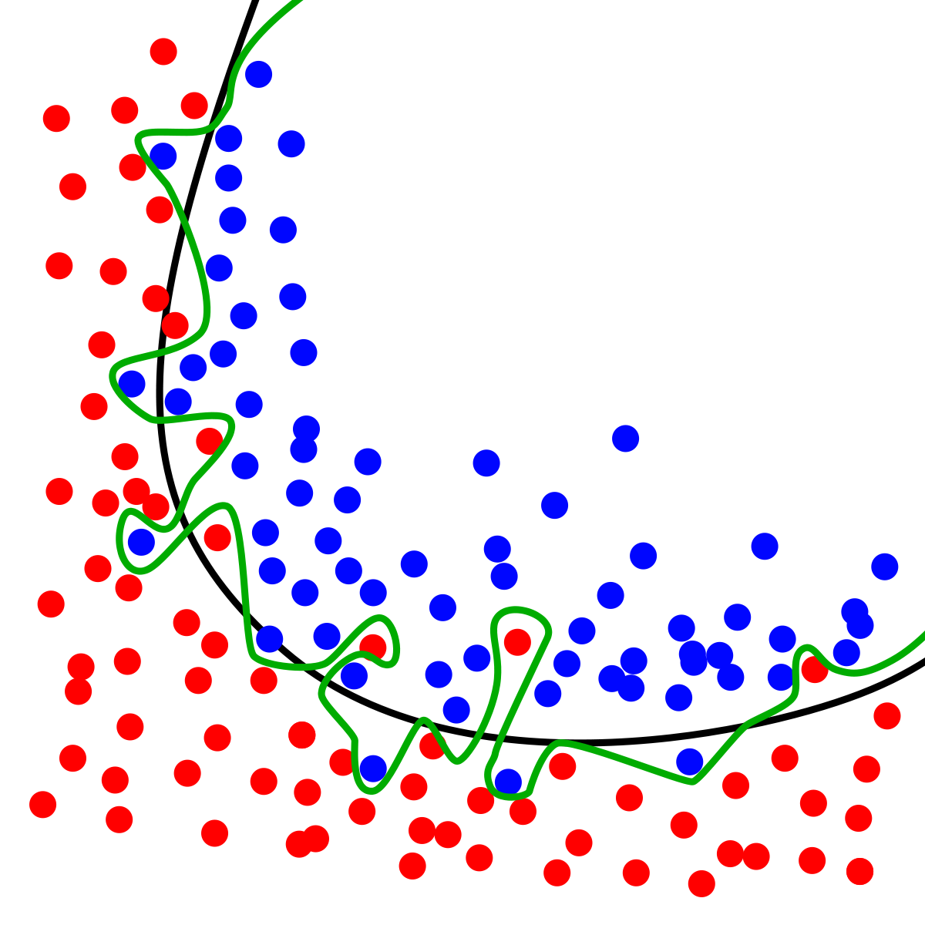
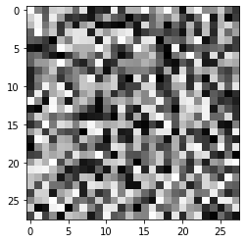
Overfitting
A Neural Network Can Easily Overfit…
Let’s look at an extreme case…

Slide 5
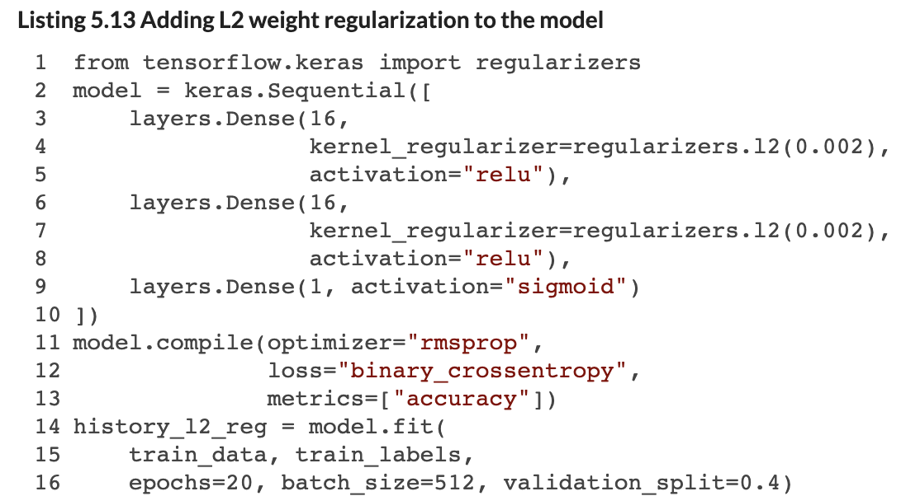
Regularizing Weights
Regularizing Weights Means Less Entropy
Regularizing a layer’s weights means the weights are updated less as their collective magnitude (e.g., sum) gets larger. Both L1 or L2 norms can be used here applied.
This approach is typically used to improve the validation performance of smaller networks.

Slide 6
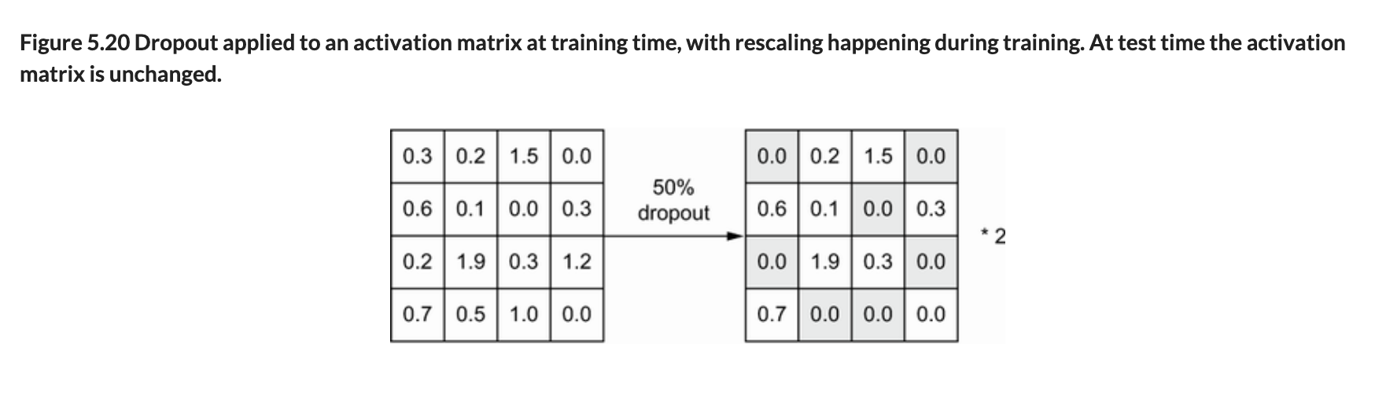
Dropout
Adding Dropout Layers to the Network
Dropout layers set a random proportion of edge weights to 0 in a given training iteration. Typically between 20% and 50% of edges.
When the final model is obtained, the 0’s are removed, and the output values are scaled down uniformly to account for the change in the number of edges.
This approach is more commonly used with large / deep networks.

Slide 7
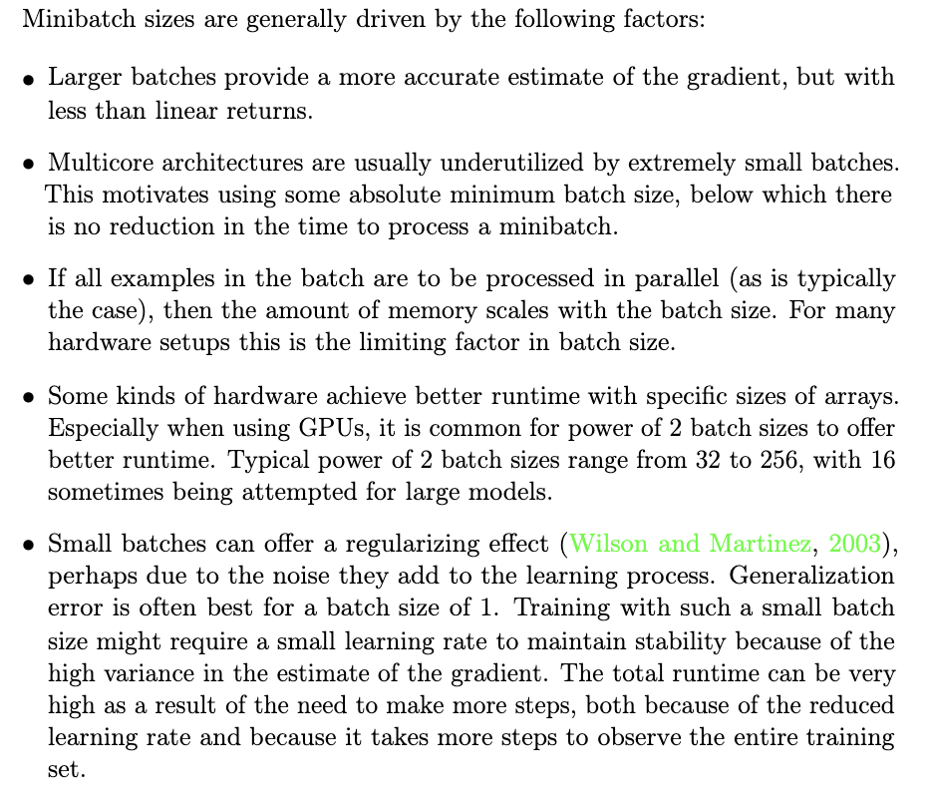
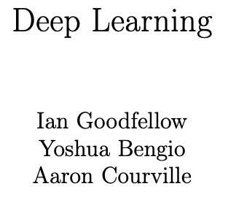
Adjust Batch Size

Slide 8

Inject Noise
Just Like Smaller Batch Size, but Purposeful
One can manually jitter model weights at each iteration by ‘adding’ random noise.
You can add noise to any model component, including the inputs, activations and outcome labels.

Slide 9

Get More Data!
More Training Examples
Means you can have a bigger training data-set, which will presumably contain more information for the model to extract.
This is the approach that often yields the best marginal returns, though it can also be most costly.

Slide 10
Some Rules of Thumb
These Are Useful Guidelines for Your First Pass at a NN
Start with 2 hidden layers.
Give the first hidden layer (num_inputs / 2) nodes and the next (num_inputs / 4) nodes. If you add layers, decay the node count in this manner as you go along.
Use ReLU (or SeLU) activations for hidden layers.
Add Dropout at every layer after the input, with a rate of 0.5 (don’t push beyond 0.5).
If learning is flat, then more nodes in each layer.
Whiten continuous input data (demean, divide by standard deviation).
Make sure you are doing cross-validation, with a test set holdout.
For classification problems, apply class weights to balance labels (in the model.fit() function).
User RMSprop or Adam as your optimizer.
Choose an appropriate loss function!
Monitor accuracy as metric for classification problems, MSE for regression.
Start with 20 epochs, increase if the validation loss has not yet reached its low point.
Start with a batch size of 16 and then double it from there.

Slide 11
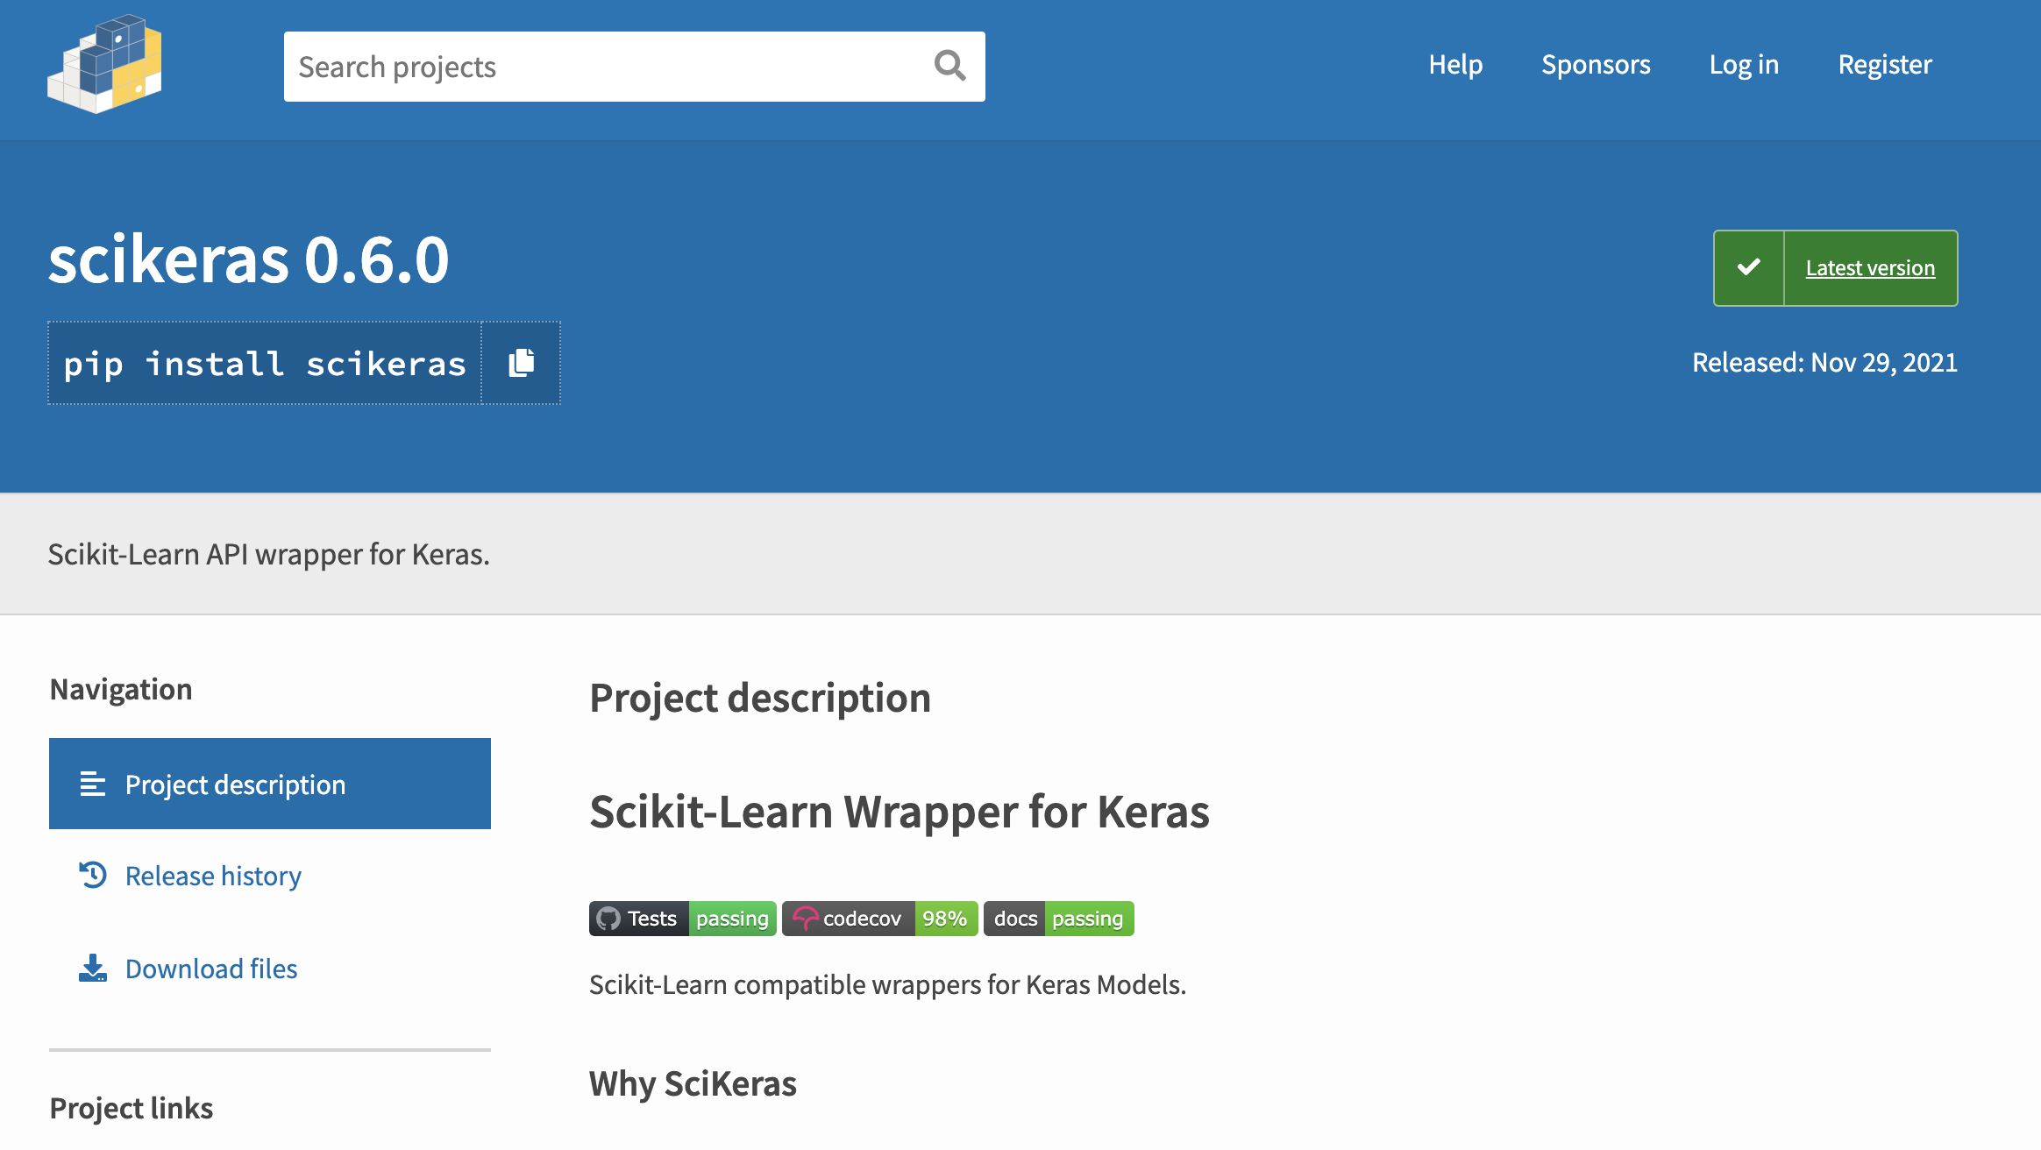
Scikit-Learn Wrapper for Keras
Facilitate Hyperparameter Tuning and Cross-validation of a Deep Net
These wrappers can be used with the Sequential API, with two caveats:
First, you need to formally specify the shape of the input layer.
Second, you need to install scikeras in Google colab to use it.

Slide 12
Let’s Walk Through Several Examples
Notes:
Note that I don’t expect you to implement a neural network from scratch. This is just to give you an understanding of how they work.

Slide 13
Individual Assignment
Basic Prediction Exercise
I am providing you with a sample of real data from the Blue Bikeshare service (Boston bikeshare).
Your goal is to use this data to predict how long an individual’s bike rental / trip will last, at the time they begin the rental. See instructions for the assignment on Github.
Deliverable
Produce a Jupyter notebook documenting your work (include the names of the contributors at the top of your notebook). Submit the .ipynb file on Blackboard by the assignment deadline.
Make sure you comment your code well and follow the provided template so we (the TA and I) are clear what you were trying to do! Feel free to re-use code from class examples, to chat at a high level with other students about approach, or to use ChatGPT. However, you should not copy or re-use other students code.
Answer conceptual questions laid out in the assignment document.
Document your use of ChatGPT (include the prompts you used and screenshot output).
State which other students you spoke to / interacted with when brainstorming how to solve the assignment.
Notes:
Note that I don’t expect you to implement a neural network from scratch. This is just to give you an understanding of how they work.

Slide 14
Start Working Now…
Notes:
Note that I don’t expect you to implement a neural network from scratch. This is just to give you an understanding of how they work.

